Slide 1


Lengthy Relationships and Footsteps in Time
Adapted from: “Lengthy Relationships” & "Footsteps in Time" © 1999 ENSI (Evolution & the Nature of Science Institutes) www.indiana.edu/~ensiweb

Slide 2
Lengthy Relationships
Data from Biology students
Leg Length
Height
Stride Walking
Stride Running
Foot Size
What are the relationships you see in the graphs?
Does gender play a role?

Slide 3
Male Students
leg/foot | Nw | Nr | Sw (cm) | Sr (cm) | Males | Height(cm) | Leg Length | Foot
3.40 | 22 | 11 | 68.18 | 136.36 |  | 170 | 85 | 25.00
3.44 | 20 | 10.5 | 75.00 | 142.86 |  | 177 | 93 | 27.00
3.48 | 19 | 11.5 | 78.95 | 130.43 |  | 174 | 94 | 27.00
4.12 | 21 | 12 | 71.43 | 125.00 |  | 187 | 105 | 25.50
3.86 | 16 | 9 | 93.75 | 166.67 |  | 190 | 112 | 29.00
4.41 | 16 | 10 | 93.75 | 150.00 |  | 191 | 119 | 27.00
3.38 | 22 | 16 | 68.18 | 93.75 |  | 170 | 93 | 27.50
3.70 | 18.5 | 10 | 81.08 | 150.00 |  | 183 | 100 | 27.00
3.31 | 21.75 | 12.5 | 68.97 | 120.00 |  | 162 | 91 | 27.50
3.17 | 19.5 | 9.5 | 76.92 | 157.89 |  | 173 | 92 | 29.00
3.71 | 22 | 14 | 68.18 | 107.14 |  | 171 | 94.5 | 25.50
3.25 | 21.5 | 12.5 | 69.77 | 120.00 |  | 166 | 91 | 28.00
3.77 | 20.5 | 11 | 73.17 | 136.36 |  | 175 | 98 | 26.00
3.84 | 20 | 13 | 75.00 | 115.38 |  | 177 | 96 | 25.00
3.63 | 19.98 | 11.61 | 75.88 | 132.28 |  | 176.14 | 97.39 | 26.86
Mean:
Nw (number of steps walking heel to heel for 15 m (1500 cm)
Nr (number of steps running heel to heel for 15 m (1500 cm)
Sw (average stride walking in cm)
Sr (average stride walking in cm)

Slide 4
Female Students
leg/foot | Nw | Nr | Sw (cm) | Sr (cm) |  | Height(cm) | Leg Length | Foot
4.04 | 21 | 14 | 71.43 | 107.14 |  | 165 | 93 | 23.00
3.67 | 21 | 15 | 71.43 | 100.00 |  | 162 | 88 | 24.00
3.81 | 24.5 | 15 | 61.22 | 100.00 |  | 152 | 80 | 21.00
3.78 | 20.5 | 13.5 | 73.17 | 111.11 |  | 163 | 87 | 23.00
3.52 | 19.5 | 10.5 | 76.92 | 142.86 |  | 168 | 81 | 23.00
4.00 | 18.5 | 11.5 | 81.08 | 130.43 |  | 175 | 92 | 23.00
3.83 | 21 | 13.5 | 71.43 | 111.11 |  | 165 | 92 | 24.00
3.95 | 22.5 | 13.25 | 66.67 | 113.21 |  | 170 | 87 | 22.00
3.96 | 19 | 13.5 | 78.95 | 111.11 |  | 183 | 91 | 23.00
4.17 | 20 | 14 | 75.00 | 107.14 |  | 164 | 96 | 23.00
3.86 | 21.5 | 15.5 | 69.77 | 96.77 |  | 160 | 81 | 21.00
3.96 | 17.5 | 13 | 85.71 | 115.38 |  | 179 | 99 | 25.00
4.09 | 25 | 16 | 60.00 | 93.75 |  | 170 | 94 | 23.00
3.91 | 19.5 | 13 | 76.92 | 115.38 |  | 167 | 90 | 23.00
3.83 | 25.5 | 15 | 58.82 | 100.00 |  | 163 | 88 | 23.00
4.27 | 21 | 14 | 71.43 | 107.14 |  | 161 | 94 | 22.00
4.00 | 22 | 14.5 | 68.18 | 103.45 |  | 164 | 92 | 23.00
3.92 | 21.15 | 13.81 | 71.66 | 109.76 |  | 166.53 | 89.71 | 23.10
Mean:
Nw (number of steps walking heel to heel for 15 m (1500 cm)
Nr (number of steps running heel to heel for 15 m (1500 cm)
Sw (average stride walking in cm)
Sr (average stride walking in cm)

Slide 5
How does gender play a role in lengthy relationships?
Means | leg/foot | Nw | Nr | Sw (cm) | Sr (cm) |  | Height(cm) | Leg Length | Foot
Male | 3.63 | 19.98 | 11.61 | 75.88 | 132.28 |  | 176.14 | 97.39 | 26.86
Female | 3.92 | 21.15 | 13.81 | 71.66 | 109.76 |  | 166.53 | 89.71 | 23.10
Nw (number of steps walking heel to heel for 15 m (1500 cm)
Nr (number of steps running heel to heel for 15 m (1500 cm)
Sw (average stride walking in cm)
Sr (average stride walking in cm)
Average Leg Length to Foot Length ratio for all students is 3.76,
closer to which gender?

Slide 6
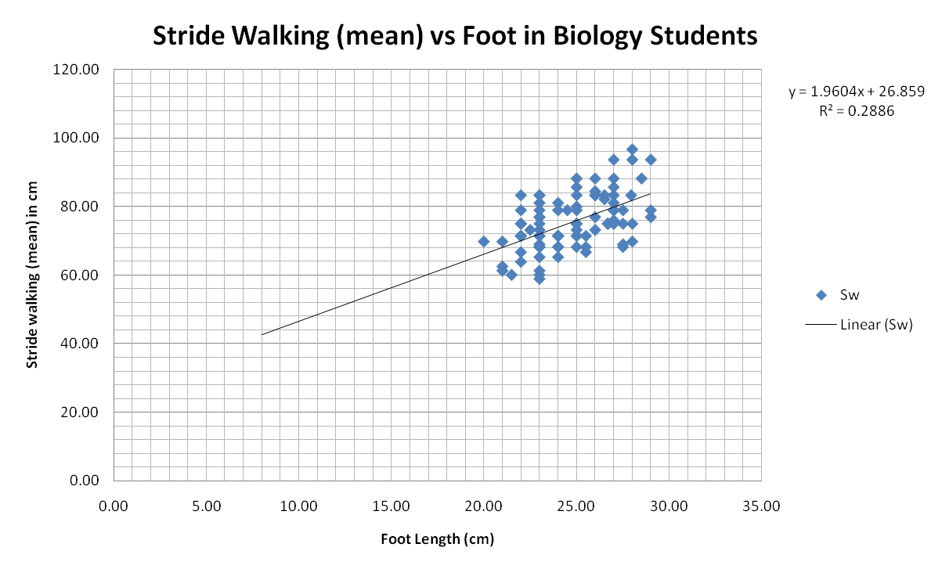
Combined Class Data: 3 classes, 94 students
Ages 14-18 (why is R² so low?) Why was it necessary to forecast the trend line back so far?

Slide 7
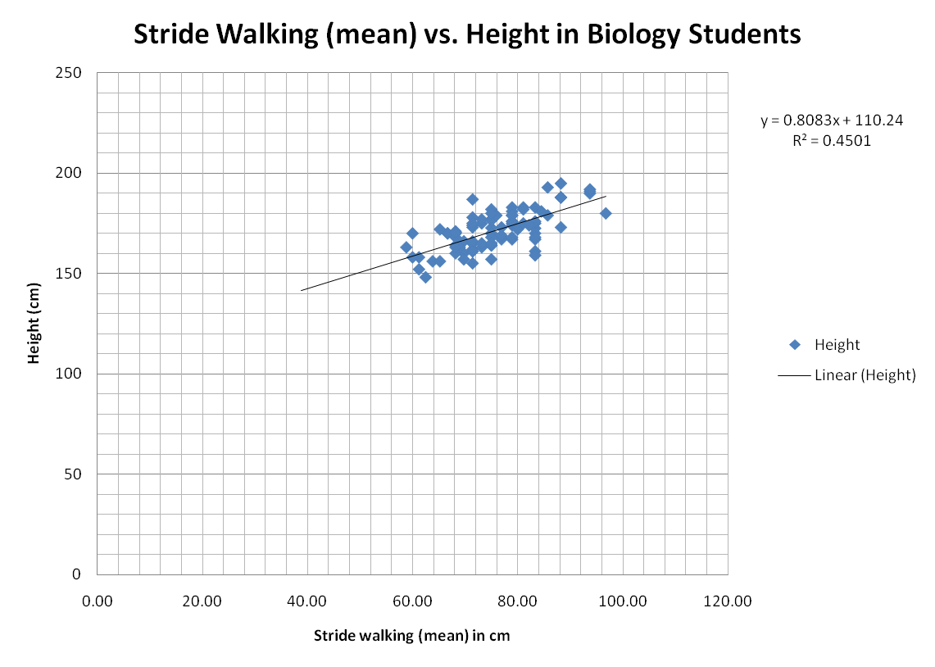
What is the relationship you see between stride walking and height in students?

Slide 8
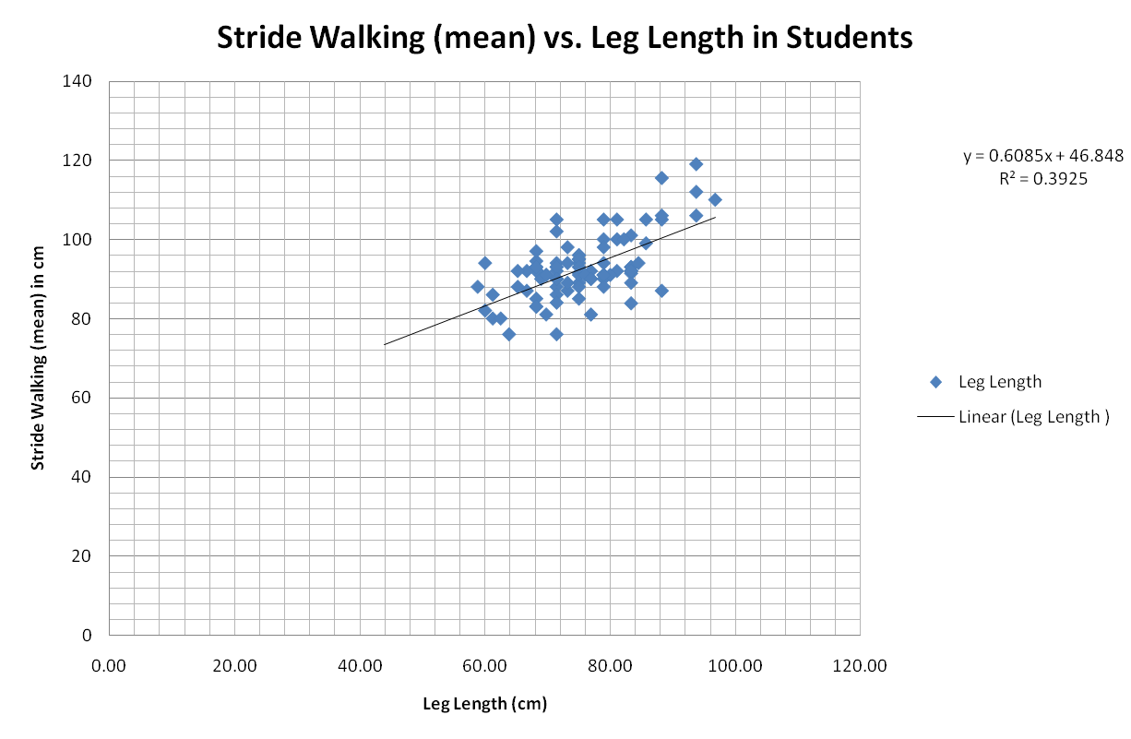
Any surprises???

Slide 9
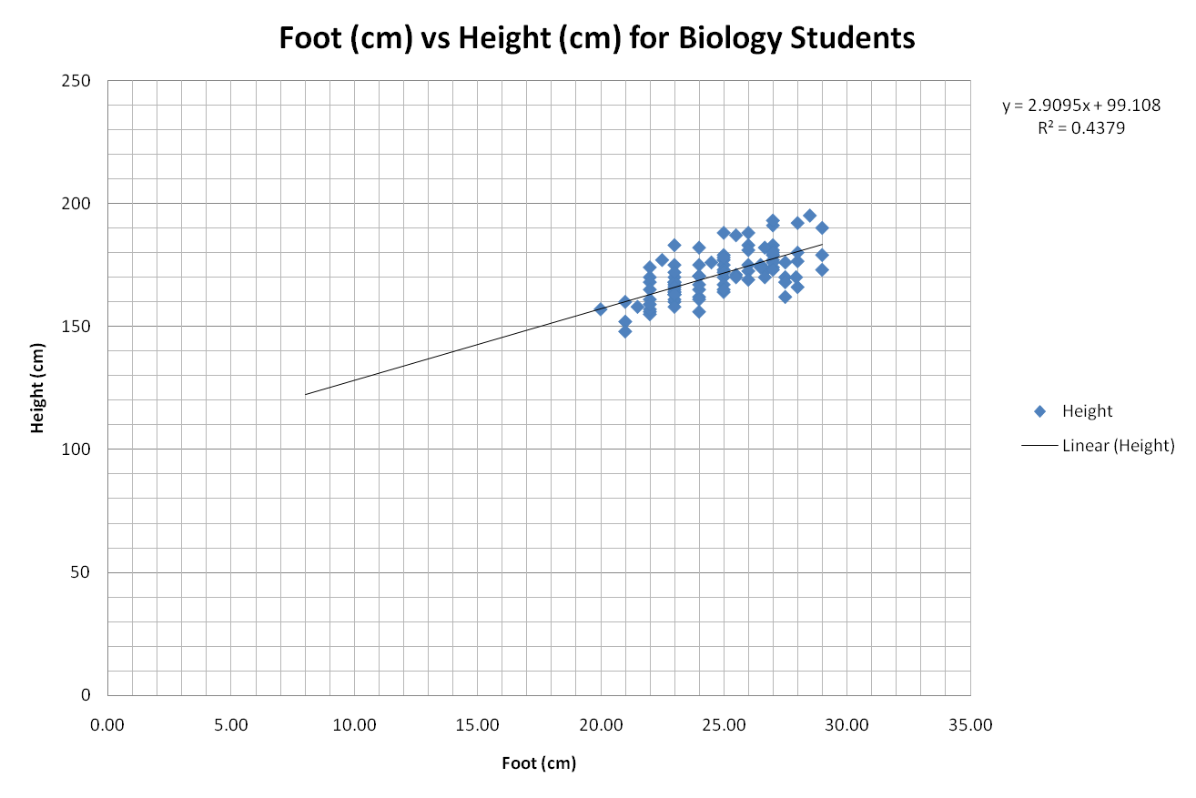
Line 2: from trendline to
y –axis to read height
Line 1: from a 20 cm foot to the trendline
Using a graph to predict… if a foot is 20 cm how tall would you predict the height of a person. And the answer is _____?

Slide 10
Conclusion & Analysis Questions need to be answered in your journal
CONCLUSION
1. Do you see a pattern on the graph? Explain.
2. Superimpose all (or several of) the group's graphs and determine if there are any relationships between the variables.
3. Determine if foot length can be used to predict height. Test you hypothesis by measuring a person's foot length and using your graphs to predict the height. Now, measure the height of that person. How close are you to the actual height? Calculate your percent error (difference between predicted and actual, divided by the actual, all times 100). Explain.
4. Pool the class data for the ratio of Leg Length to Foot Length. What is the average L/F ratio for people based on the class data?
5. Paleontologists use the ratio of stride length divided by leg length (S/L) to tell whether a dinosaur is walking, trotting, or running. Paleontologists use the following values to determine how a dinosaur might have been moving.
<2 walking 2 - 2.9 trotting >2.9 running
Examine the class data for the ratios of stride to leg length (Sw/L and Sr/L) to see if the values in the above chart would also apply to people.If not, what values would change?

Slide 11
ANALYSIS
1. If a person's footprints were discovered in someone's backyard, what information could be determined about the person who made the footprints? What information about the person could not be determined from the footprints?
2. If you had a dinosaur track way, how could you use the processes we learned in this activity to draw some conclusions about the dinosaurs which made the tracks?
3. Why did you count your stride over a 1500cm length rather than make only one stride measurement?
4. Below is a series of footprints found in the mud outside school. Based upon the measurements given, calculate the leg length and heigth of the person. Who do you think the footprint belongs to? Write a paragraph describing what the person was doing.
Foot Length = 29 cm; Stride Length = 160 cm

Slide 12
How Tall were They? Laetoli Pathway
"One of the most remarkable events in the annals of anthropology occurred (over) 20 years ago in an area of northern Tanzania called Laetoli. A team lead by famed archaeologist Mary D. Leakey was searching for fossils of early hominids that ranged through East Africa millions of years ago. In the summer of 1976, after a long day in the field, three visitors to Leakey's camp engaged in some horseplay tossing chucks of dried elephant dung ant one another.
When paleontologist Andrew Hill dropped to the ground to avoid being hit, he noticed what seemed to be animal tracks in a layer of exposed tuff- a sedimentary rock created by deposits of volcanic ash. On closer inspection of the area, the scientists found thousands of fossilized tracks, including the footprints of elephants giraffes, rhinoceroses, and several extinct mammal species.
The most extraordinary find came two years later, when Paul I. Abell, a geochemist who had joined Leakey's team found what appeared to be a human footprint at the edge of a gully eroded by the Ngarusi River. excavations of the Footprint Tuff, as it came to be known, in 1978 and 1979 revealed two parallel trails of hominid footprints extending some 27 meters (89 feet). the volcanic sediments were dated radiometrically to be between 3.4 million and 3.8 million years old." (Agnew, Neville and Demas. Scientific American. :Preserving the Laetoli Footprints." September 1998. P. 45-66.)

Slide 13
How Tall were They Instructions:
http://www.teachersdomain.org/resource/tdc02.sci.life.evo.laetolifoot/
or
http://www.youtube.com/watch?v=w1Lu4VggDH0
Objective: How do we determine the height of hominids based on foot length?
Procedure:
1. Look at the Northern and Southern sections of the Laetoli trackway. Create a hypothesis (in your journal) about who could have left those footprints. Be as descriptive as possible (i.e. what type of organism make the footprints, what were they doing, and how old are these organisms?)
(see next slide)
2. Inspect the G1-27 and G1-33 footprints. How could you determine the height of these organisms? How could you determine how the footprints were made? (Did you notice that one of the footprints is actually a left foot, check out the southern portion of the trackway?)

Slide 14
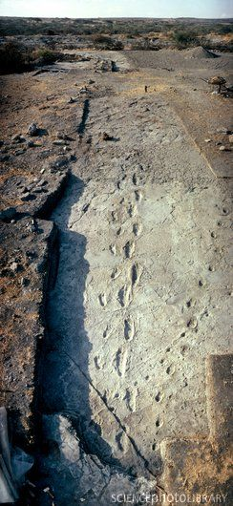
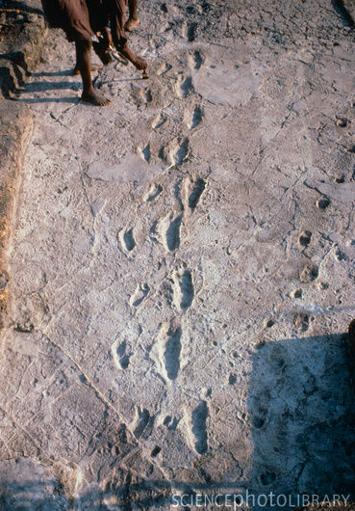
Hoof prints
Foot prints

Slide 15
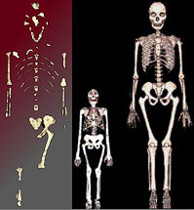
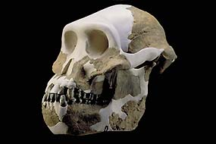
Who walked here 3.5 million
years ago?
Lucy's skeleton and Lucy vs. modern human female
The distinctive characteristics of A. afarensis were:
a low forehead
bony ridge over the eyes
a flat nose and no chin
more humanlike teeth,
and the pelvis and leg bones resembled those of modern man.
Females were smaller than males. (sexual dimorphism).

Slide 16
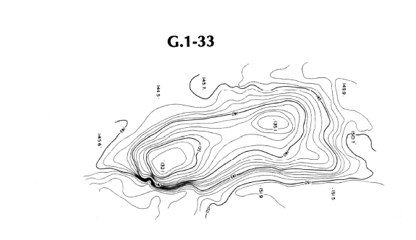
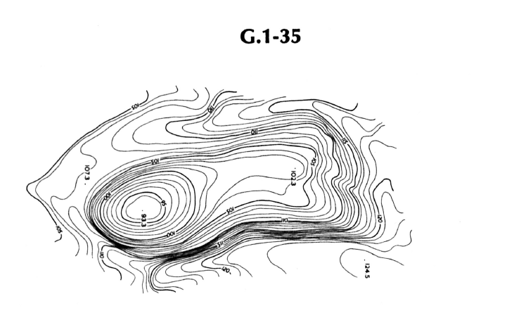
Topographic maps of Laetoli Footprints: G.1 (person 1, step 33 and step 35)
What do you think is shown here?
What do you think is shown here?

Slide 17
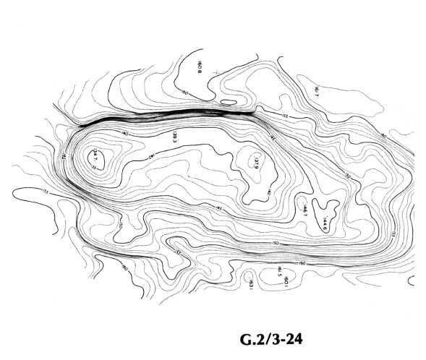
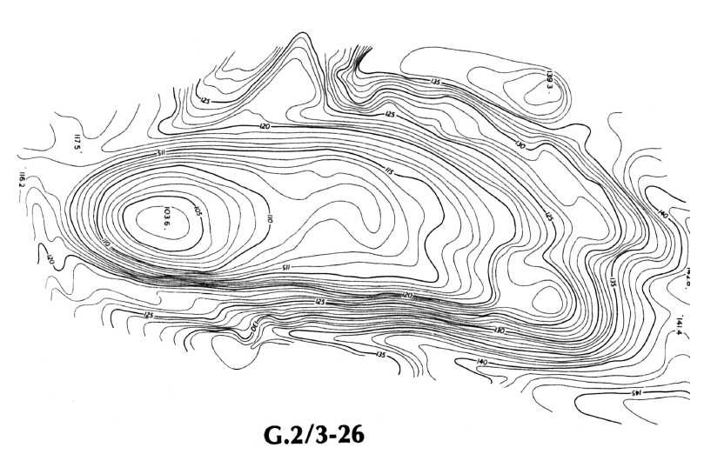
G2/G3 (two people) step 24 and step 25, do you see the 2 footprints?

Slide 18
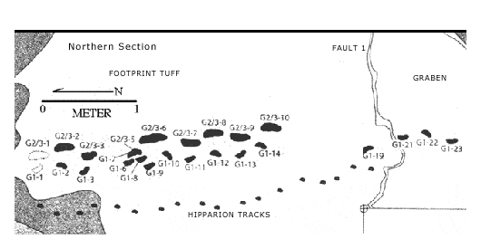
This the Northern Section of the walkway, notice the number are going backwards… why do you think this is happening, note that G1 is walking across the lower part of the track, why would G2 and G3 tracks be overlapping (think walking in the sand.)

Slide 19
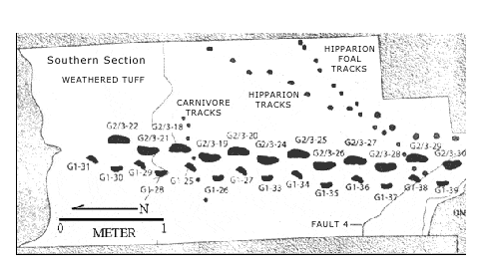
Here is the Southern Section, remember tuff is fossilized ash, weathered means _____? The track you will use has a scale of 1 meter = 44.5 mm or 4.45 cm. There are also fossilized animal tracks of a Hipparion and a foal (Hipparions were horse like (picture on next slide). Where the hipparion and the carnivore and the Australopitheicus afarensis there at the same time? Look at the stride lengths (and don’t forget that foals like to hop about).

Slide 20
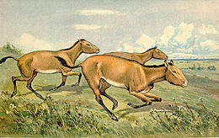
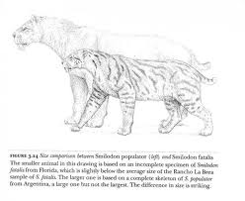
Dinner???
Hipparion (Greek, "pony") is an extinct genus of horse living in North America, Asia, Europe, and Africa during the Miocene through Pleistocene ~23 Mya—781,000 years ago, existing for 22.219 million years (genus including species). Hipparion sp. (~12.7 Ma—781,000) existed for approximately 11.919 million years.
Miomachairodus was an extinct genus of large saber-toothed cats of the subfamily Machairodontinae, that lived in Europe, Asia, Africa, and North America during most of the Miocene. It survived until the Late Miocene (early Vallesian
http://en.wikipedia.org/wiki/Hipparion
http://en.wikipedia.org/wiki/Miomachairodus

Slide 21
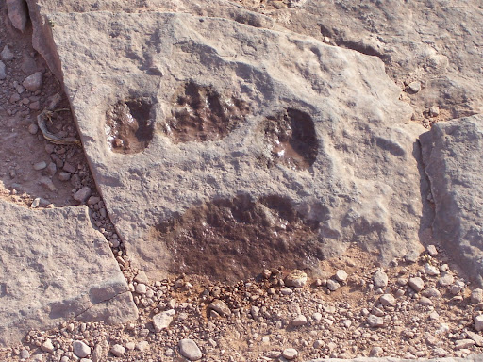
Saber Toothed Cat paw prints

Slide 22
3. In order to answer the previous two questions, develop a hypothesis and procedure to test your hypothesis in class, then:
a) measure each footprint, using your lengthy relationship data, determine the height of the person.
b) measure the stride distance for the G1 person on the trackway, take several measurements and determine the mean, then convert the mean from the scaled down trackway to the actual stride distance using the scale information on the trackway. Determine your height from the lengthy relationship graph you made earlier. (Note 44.5 mm of trackway is equal to 1 meter actual distance; take the scale measurement divide by 44.5 and the value will be a decimal which multiplied by 100 is in cm).
Calculation Example:
1 meter/ 4.45 cm = x (actual stride) / average stride from diagram
4.45 cm x = 1 meter/ 1.92 cm; x = 0.43 m
c) measure the plaster cast footprints of the female and male students (use the walking plaster cast); determine your height from the lengthy relationship graph you made earlier.
d) make a sand print of your footprint in the moist sand in the classroom, measure your footprint in cm and determine your height from the lengthy relationship graph you made earlier.
4. Create a data table for your experiment and record class data (in centimeters).
5. NOTE: the actual height of the male plaster cast footprint is 6' 6", the female is 5' 2" (convert the height to inches and then multiple by 2.54 to convert to cm). The actual height of A. afarensis is between 1.0 -1.3 meters. (remember that 100 cm = 1 meter).

Slide 23
Post Lab Questions: (due in your journal)
1 Determine the percent error for the plaster cast height (get correct height from teacher***). Use the formula below; (the absolute value of the actual height minus the estimated height divided by the actual height, then multiply by 100). Remember the actual heights are listed in procedure #5 and the estimated height is determined by using the graphs made in the lengthy relationship activity.
|actual height-estimated height| / actual height x 100 = % error
2. Taking into consideration the % error above, calculate the height range for the organism that made the G1-27 and G1-33 footprints.
3. What factors could have influenced the quality of the footprints?
4. Write a short story describing how the footprints were originally made? Include any information that you know about the area and time period. Be creative, make a comic strip, poem, jingle, etc.
Lastly, there is wet sand in the front of the classroom, make a print of your bare foot measure it and then measure your actual footprint, using the graph how accurate is your height? (do an error analysis).
*** Male plaster foot’s height : 6’6” (remember to convert to cm… 2.54 cm = 1 inch)
*** Female plaster foot’s height: 5’2”

